Slide 1


Reference Architecture Centric Construct/Fast Forge
Shawn Wallace
July 2021
NOTICE: PROPRIETARY AND CONFIDENTIAL
This material is proprietary to and contains trade secrets and information which is solely the property of Centric Consulting, LLC. It is solely for the Client’s internal use and shall not be used, reproduced, copied, disclosed, transmitted, in whole or in part, without the express consent of Centric Consulting, LLC. © 2019 Centric Consulting, LLC. All rights reserved.

Slide 2
Fast Forge Reference Application Architecture

Slide 3
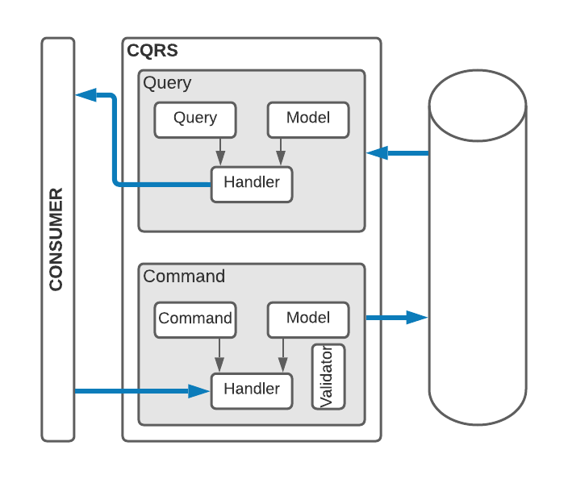
Command-Query Responsibility Segregation
Queries
Consumer creates a Query
Query is sent to a Handler
Handler executes the Query against the database
Handler returns a Model to the Consumer
Commands
Consumer makes a changes to data and creates a Command.
The Command is sent to a Handler.
The Handler executes any Validations and (if valid) updates the database.
The response Model is returned to the Consumer.

Slide 4
Command-Query Responsibility Segregation
Benefits
Single Responsibility
Small classes
Easy to test
Agility
Easy Feature Toggling
Shortcomings
Large number of classes
Discoverability
Maintainability

Slide 5
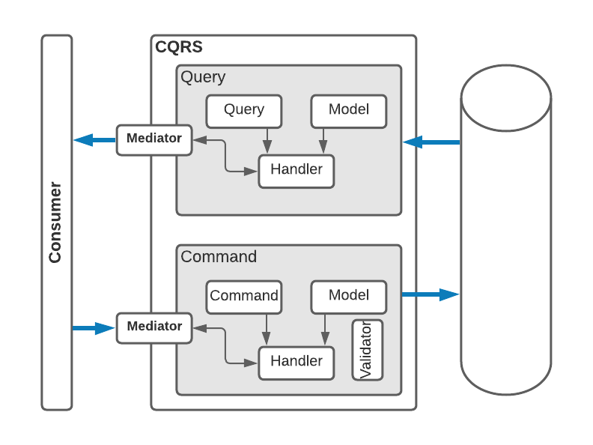
Mediator Design Pattern (full-stack)
Queries
Consumer creates a Query
Query is sent to the Mediator
Mediator determines the Handler
Handler executes the Query against the database
Handler returns a Model to the Mediator which is, in turn, sent to the Consumer
Commands
Consumer makes a changes to data and creates a Command.
The Command is sent to the Mediator.
The Handler executes any Validations and (if valid) updates the database.
The response Model is returned to the Mediator which relays it to the Consumer.
This looks like it has more steps ☹

Slide 6
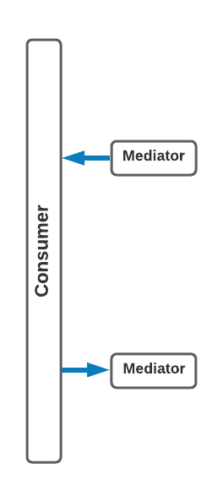
Mediator Design Pattern (from the Consumer)
Queries
Consumer creates a Query
Query is sent to the Mediator
Mediator returns a Model
Commands
Consumer makes a changes to data and creates a Command.
Mediator returns a Model
Query goes in, Model is returned
Command goes in, Model is returned

Slide 7
What Problem does Mediator Solve?
Benefits
Single Responsibility
Small classes
Easy to test
Shortcomings
Large number of classes
Discoverability
Maintainability
Goes from unusable to a great pattern.

Slide 8
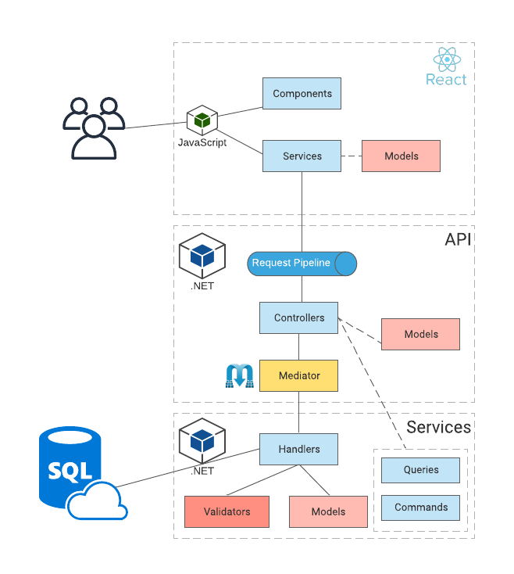
Reference Application Architecture
Tech Stack
ReactJS
.NET Core Web API
MediatR
SqlAzure
Azure Static Site
Azure App Service (Docker)

